Slide 1
Asymmetric Space Weathering on Lunar Crater Walls with an Updated Crater List
Kilho Baek¹, Sungsoo S. Kim¹, Chae Kyung Sim²
¹Kyung Hee University
²Korea Astronomy and Space Science Institute

Slide 2
Background
Space Weathering
Crater Walls

Slide 3
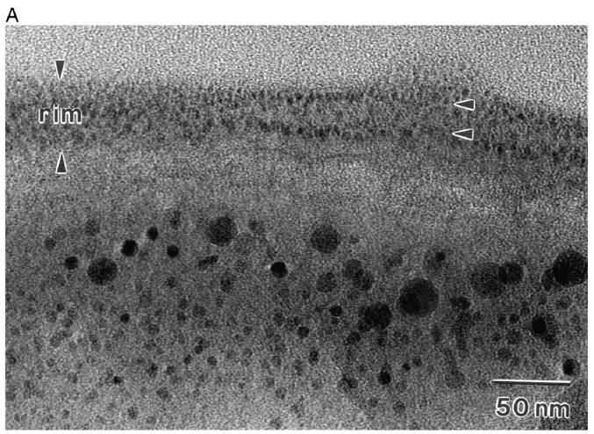
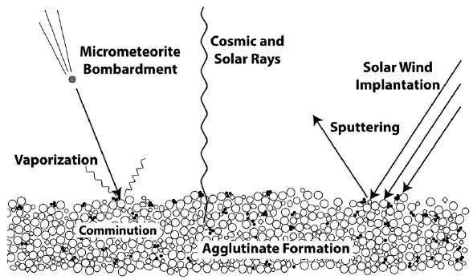
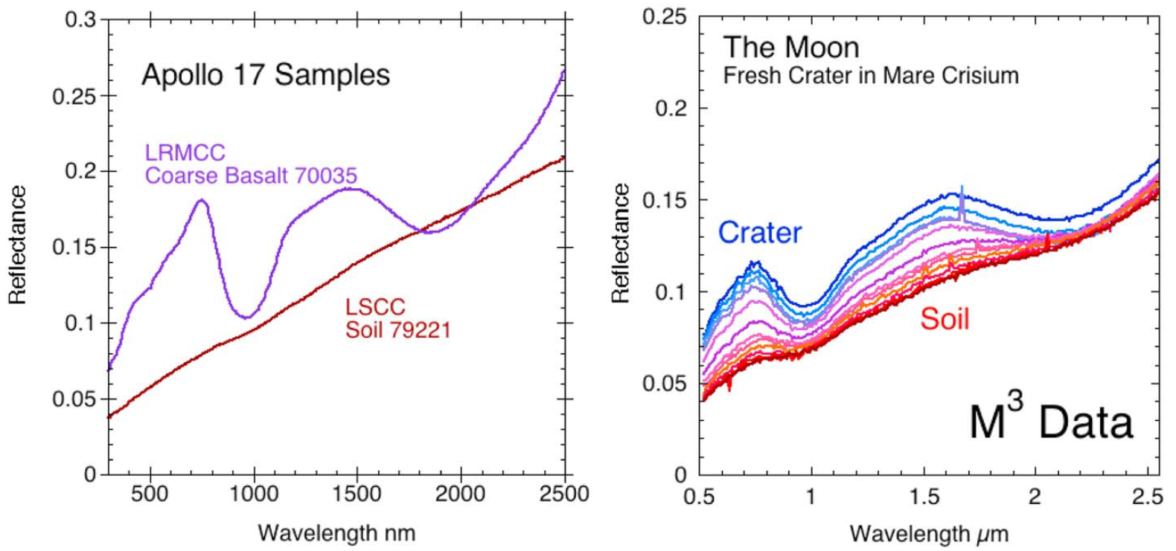

Space Weathering
Fresh Regolith
(resurfacing)
Nature
Spectral
properties
Space Weathering
microscopic alteration
(Experiments)
macroscopic data
(remote sensing)
Science
the gradual alteration of materials when they are exposed to
a variety of natural processes that occur in the space environment.
$$≈$$
soil maturity
exposure age
Pieters & Noble (2016)
npFe⁰
mpFe⁰

Slide 4
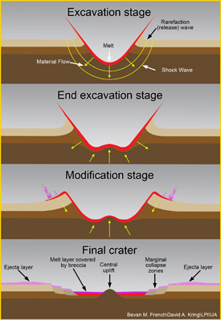
Why Crater?
Fresh Regolith
(resurfacing)
Nature
Spectral
properties
Space Weathering
Pieters & Noble (2016)
Crater had been exposed on the surface
for the same duration after the crater was formed.

Slide 5
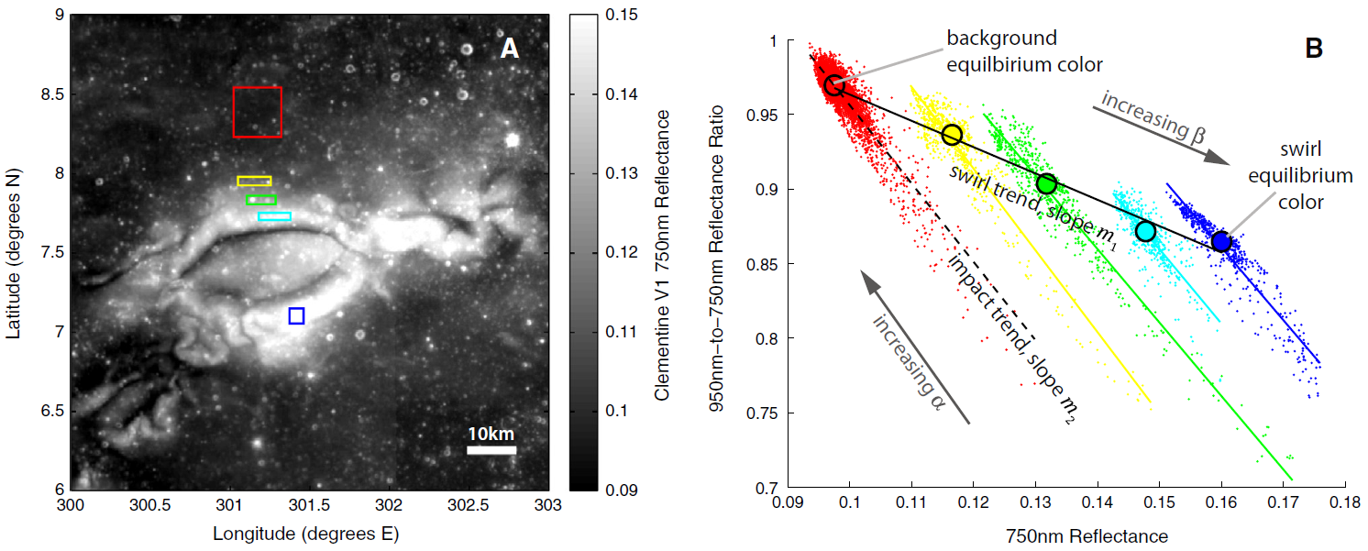
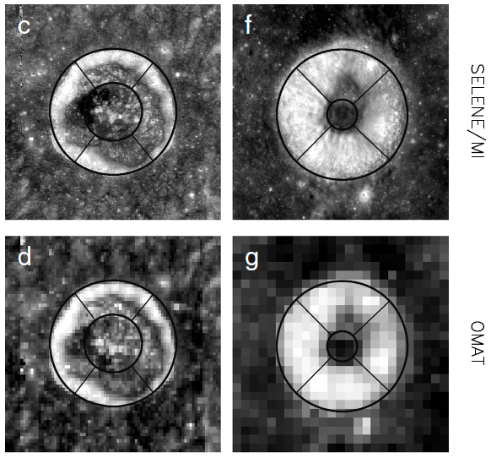
Why Crater Walls?
Hemingway et al. (2015)
STRONGER
Flux
Sim et al. (2017)
North
Pole
Equator
Facing
North
solar wind
West
Eest
Pole
Facing
South
Lat.
Equator
Lunar Swirls : different B-field
Stronger B-field
Shield more solar wind particles
less flux of solar wind particles
less space weathering
Lunar Crater Walls : different angle of incidence
Larger angle of incidence
Smaller normal vector component to crater walls
Weaker flux of solar wind particles or micro-meteorites
less space weathering

Slide 6
Data & Methods
Lunar Impact Crater Database
LOLA + Kaguya DEM & Kaguya Multiband Imager
Crater Features Defining Algorithms

Slide 7
Database & Global Map
 | Lunar Impact Crater Database (LPI 2015) | Moon Crater Database (Robbins et al., 2018)
Total Number | 8716 | ~1.3 million
Main Information | Latitude & Longitude
 | Diameter | Major/Minor-axis
 | Topography | Photometry
Data | Digital Elevation Map (DEM) | Reflectance (415 ~ 1550 nm)
Instrument | LOLA + SELENE Terrain Camera (Lunar Orbiter Laser Altimeter) | MI (Multi-band Imager)
Spacecraft | LRO (Lunar Reconnaissance Orbiter) | SELENE (Selenographical and Engineering Explorer)
Latitude | -60° ~ +60°
Resolution | 512 ppd (≈ 60 m/pixel)

Slide 8
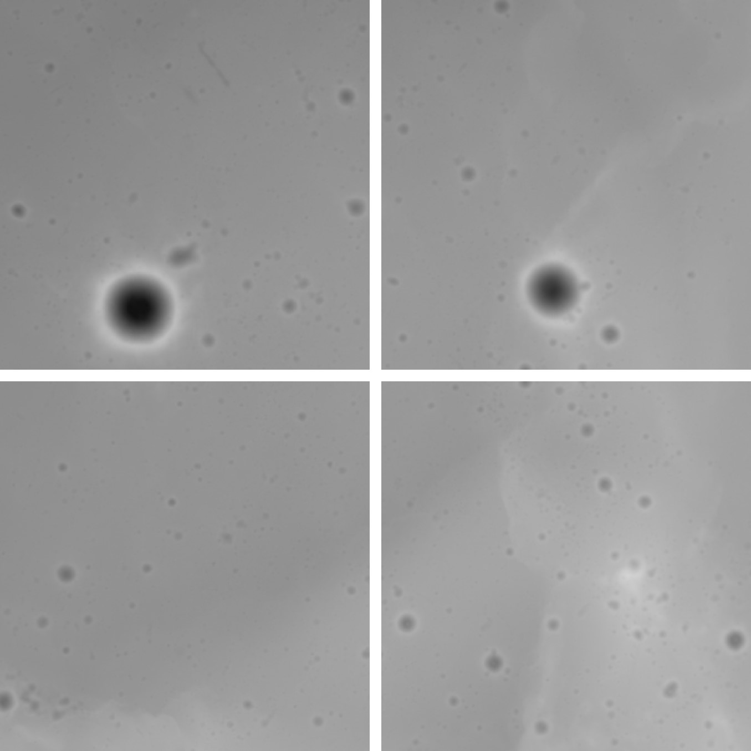
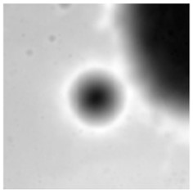
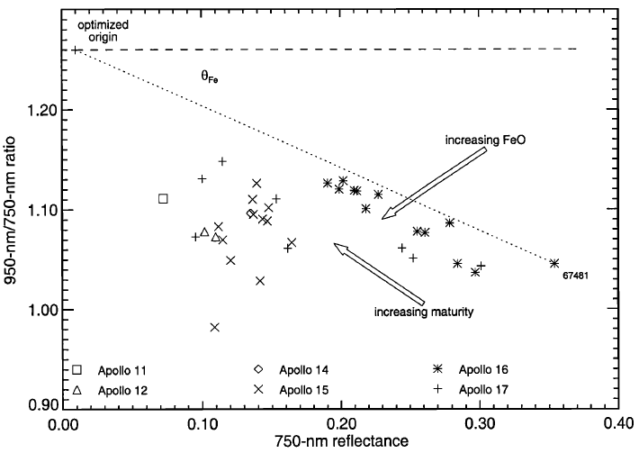
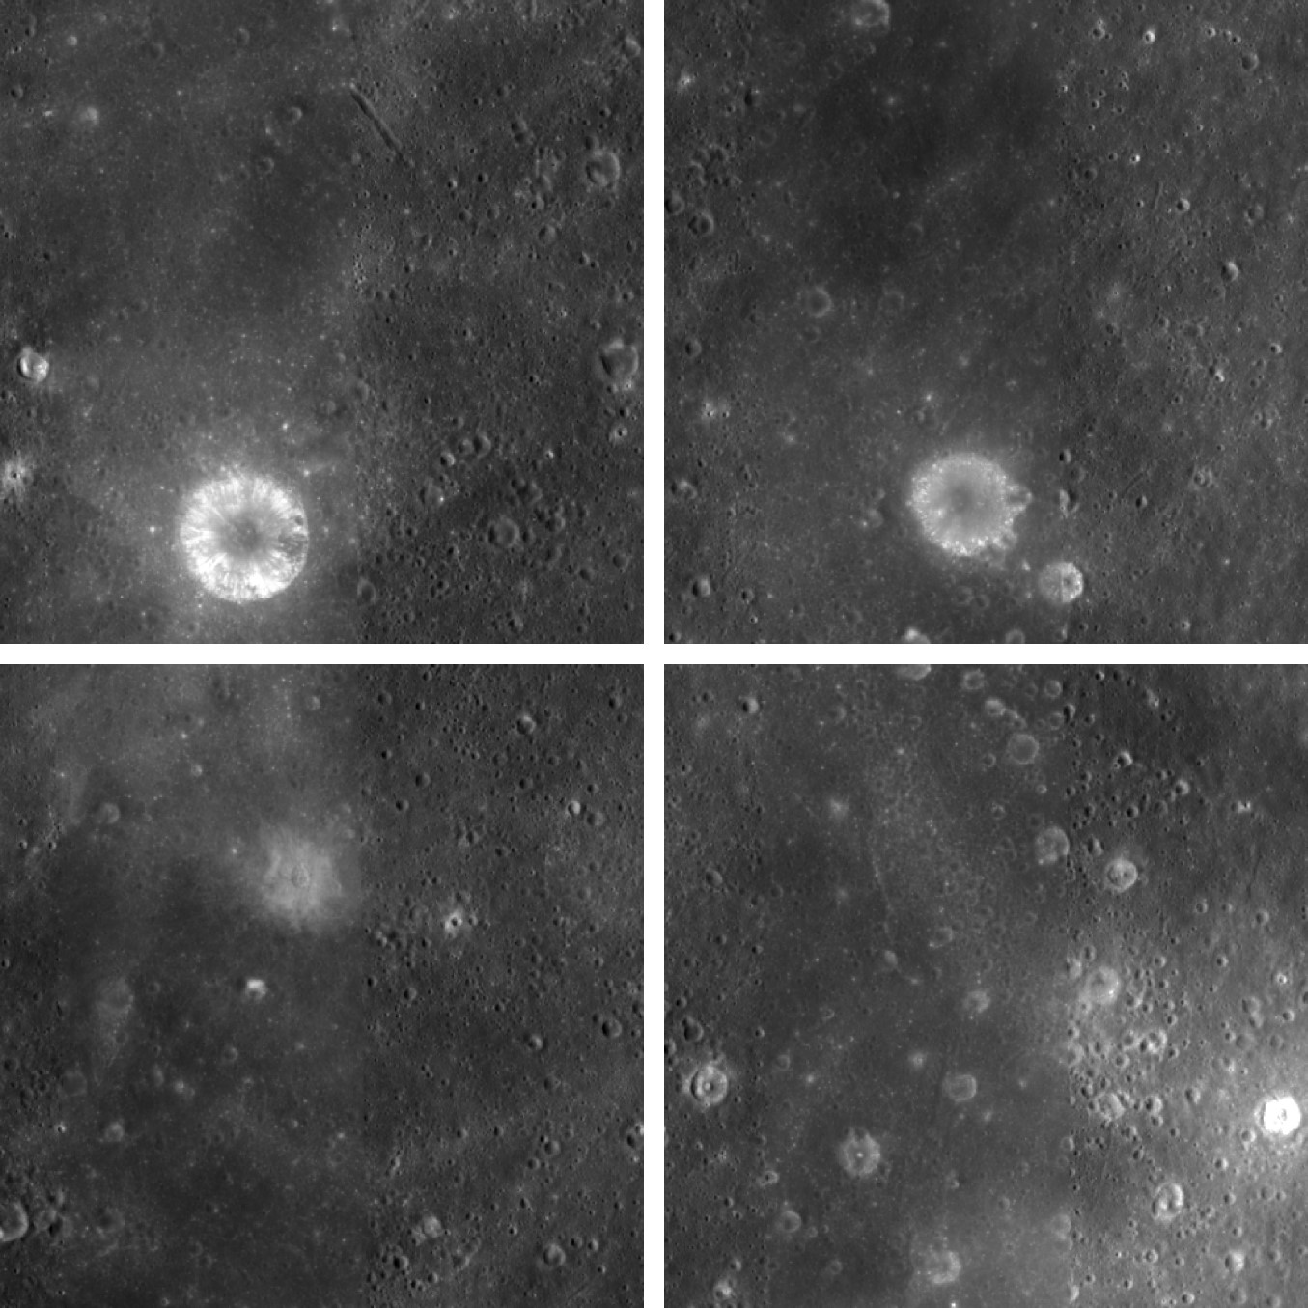
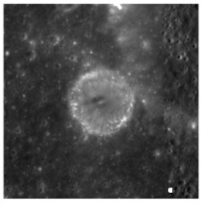
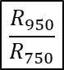

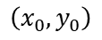


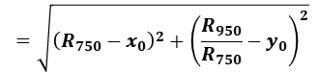


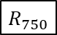
Craters & Properties
Global Mosaic
Elevation
Morphological Properties
DEM
slope
azimuth angle
diameter
(major/minor axis)
depth
reflectance : $R_{750}$, $R_{950}$
optical maturity : $OMAT$
Topography
Hyper-mature
Lucey et al. (2000)
$$\left(x_{0}, y_{0}\right)$$
$$=\sqrt{{\left(R_{750}−x_{0}\right)}^{2}+{\left(\frac{R_{950}}{R_{750}}−y_{0}\right)}^{2}}$$
$$OMAT$$
Global Mosaic
Multi-band Images
(9 bands)
Optical Properties
$$\frac{R_{950}}{R_{750}}$$
reflectance
reflectance ratio
reddening
0.95 m depth
optical maturity (OMAT)
Photometry
$$R_{750}$$
The smaller $OMAT$, the more mature.

Slide 9
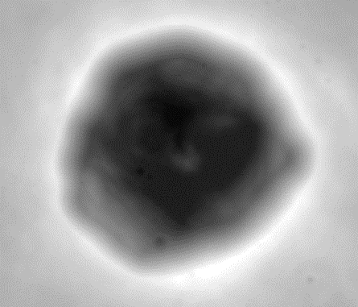
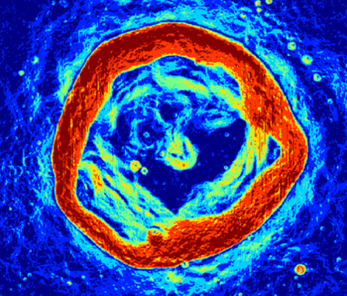
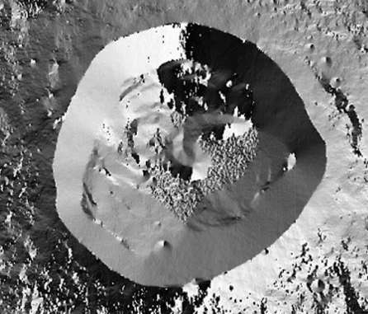
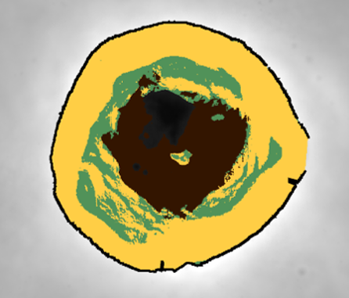
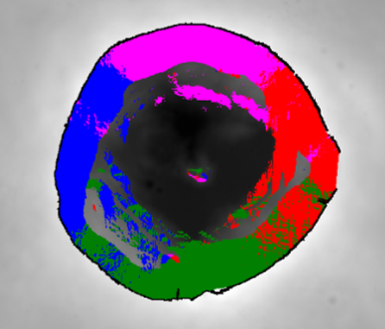
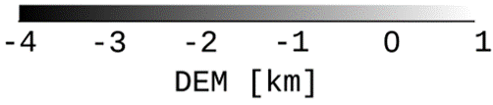
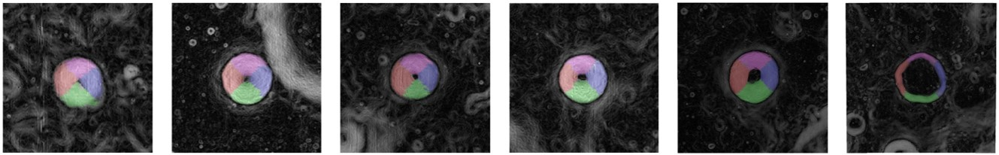
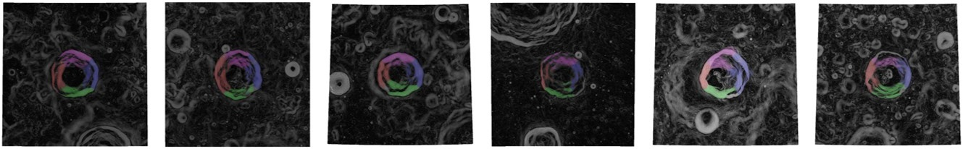
Algorithms to define crater features
DEM [km]
Slope [°]
Azimuth Angle [°]
Inner Structures
Wall-Quadrants
rim
3D vector
calculation
DEM
Slope
Azimuth
-4
-2
0
0
10
20
30
-180
0
180
Floor
Terrace
wall
E
N
S
W
Sim et al. (2017)
Simple
North
West
Eest
Complex
South

Slide 10
Results & Discussion
Latitudinal Asymmetry & Longitudinal Color Offset
Detailed Analysis Subdivided by Diameter, Slope, d/D, and OMAT

Slide 11
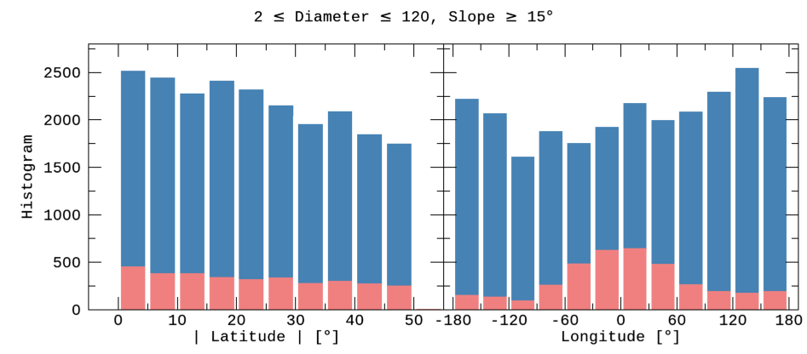
Improvements
 | Sim et al. (2017) | This study
Database | LPI (2015) |  | Robbins et al. (2018)
Samples | 1,872 | 3,144 | 26,802
Resolution | 1 km/pixel | 60 m/pixel
Diameter | 5 ~ 120 km |  | 2 ~ 150 km
2018
DB
2015
DB

Slide 12
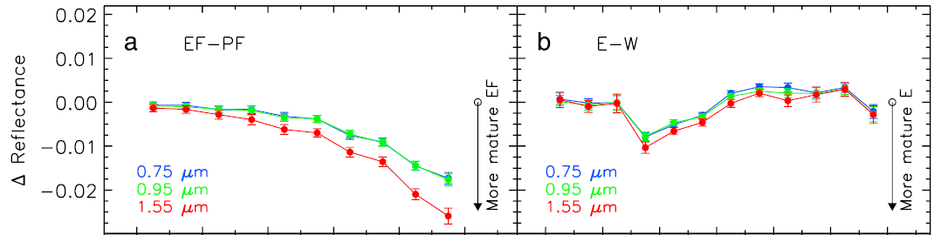
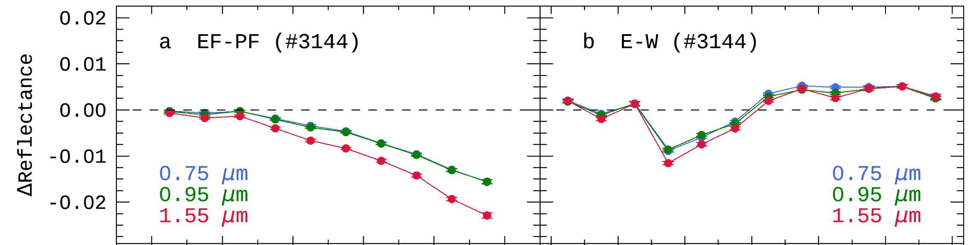
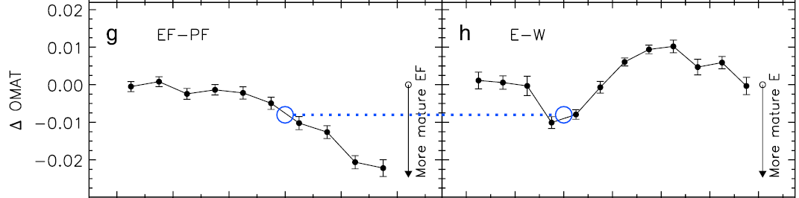
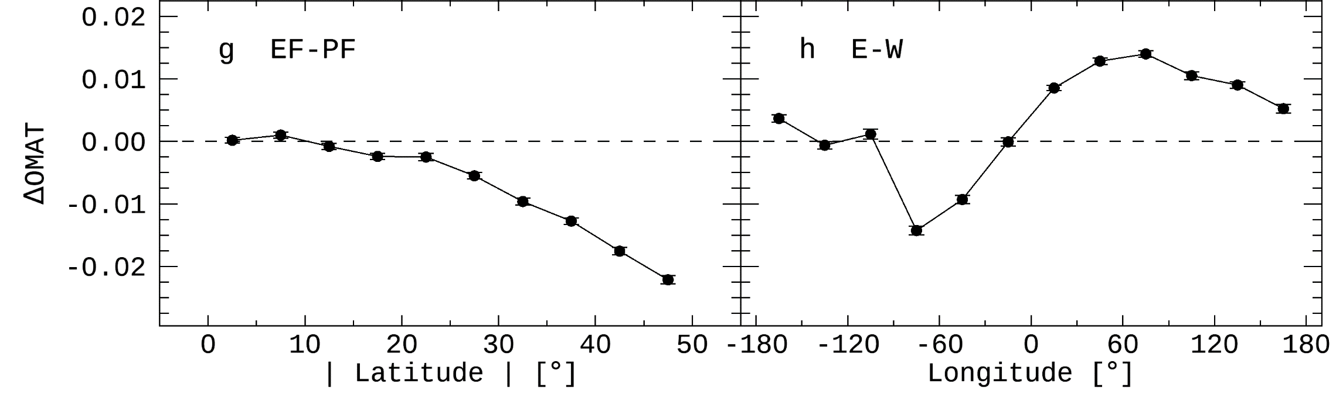
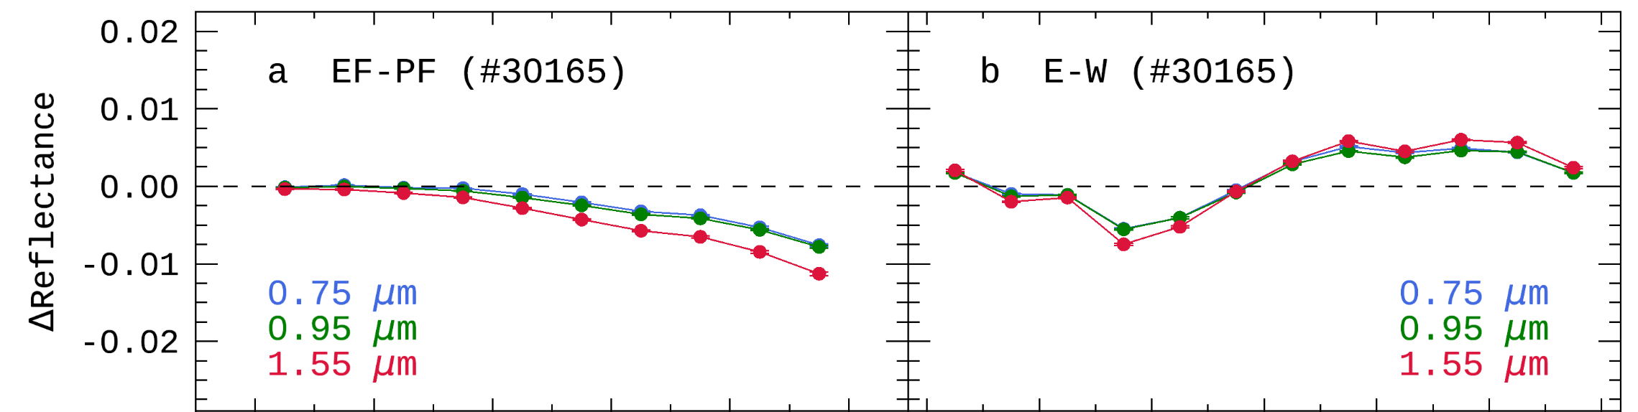
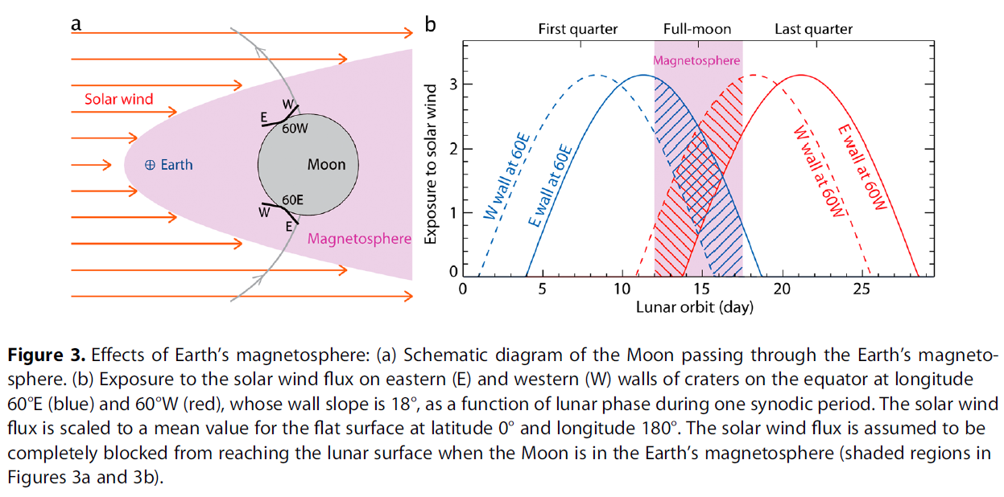
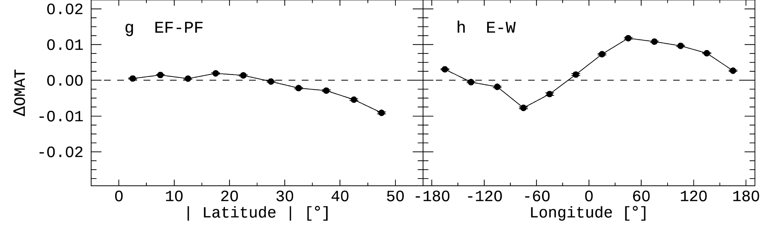
Reproduction
Sim et al. (2017) : 2015 DB
This study : 2015 DB + improved methods
This study : 2018 DB + improved methods

Slide 13
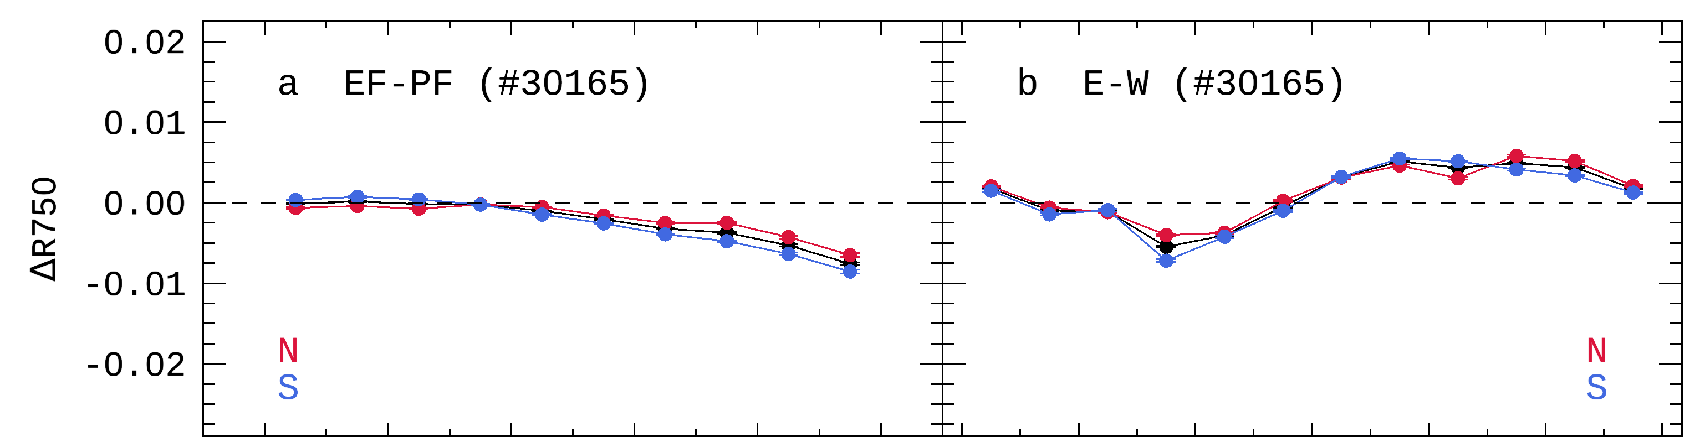
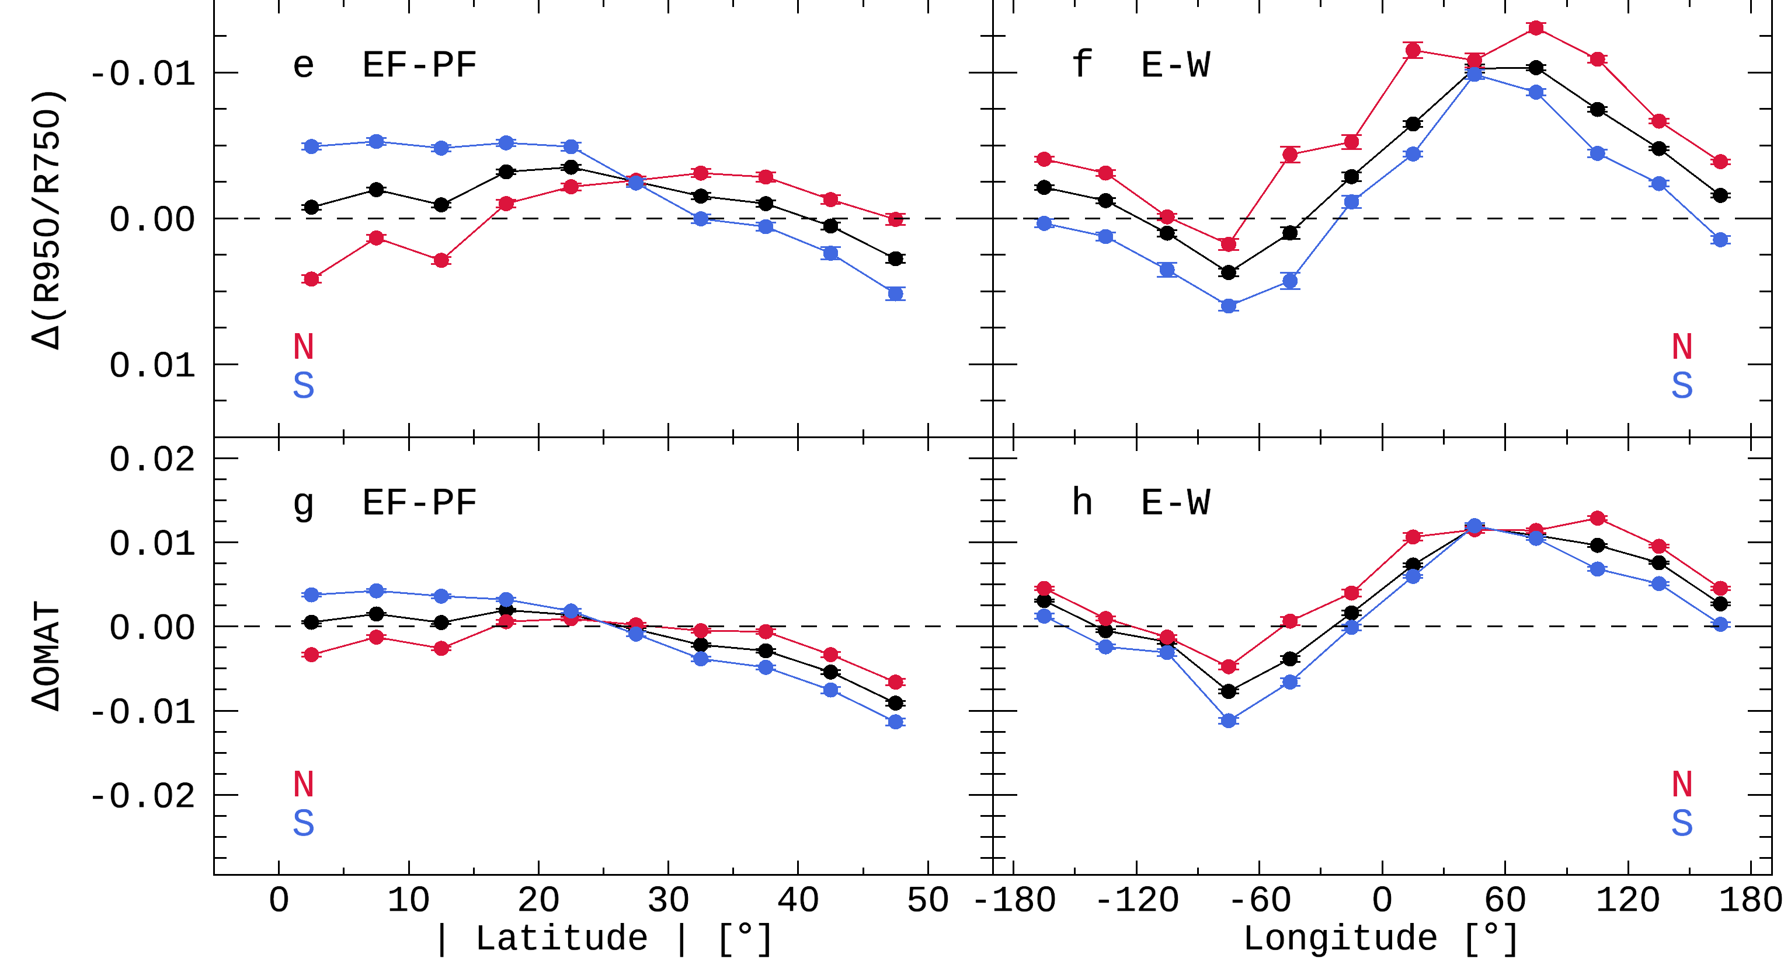
Detailed Analysis – 1: N/S hemispheres
STRONGER
Flux
North
Pole
EF wall
solar wind
PF wall
Same Flux
Lat.
Equator
Solar wind particles
enter along the ecliptic plane.
cause the trends of sine function shape in longitude affected by Earth’s magnetotail.
① Latitudinal asymmetry between northern and southern hemispheres
② Longitudinal offset caused by northern hemisphere
(micro-)meteorites
secondary particles (ejecta)

Slide 14
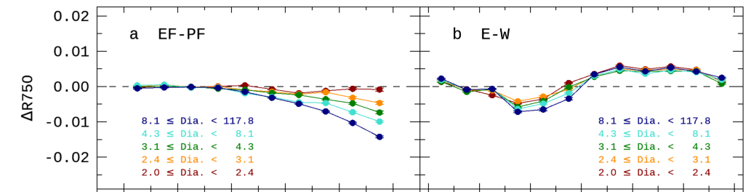
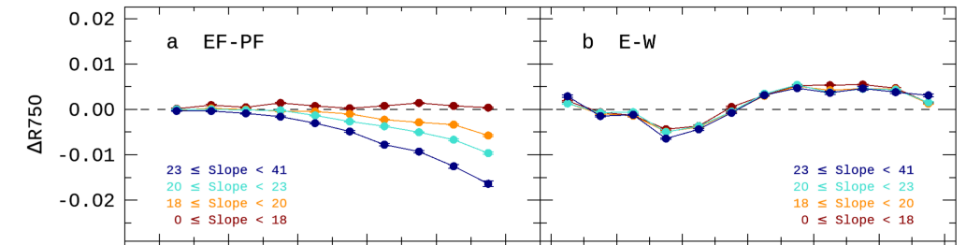
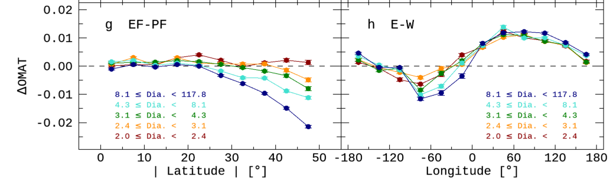
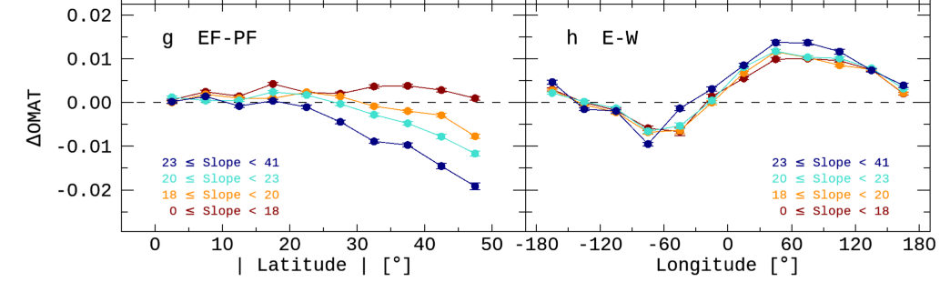
Detailed Analysis – 2: diameter, slope
Δ ~ 0 near 0 degree in latitude regardless of diameter and slope. ➔ They are not causes of latitudinal asymmetry between N- and S-hemispheres. ➔ These is no longitudinal separation to interpret the longitudinal color offset.
The red solid line is almost constant at zero regardless of the latitude, but the trends of sine function shape in longitude still appear. ➔ Solar wind particles are not the cause of the latitudinal asymmetry.

Slide 15
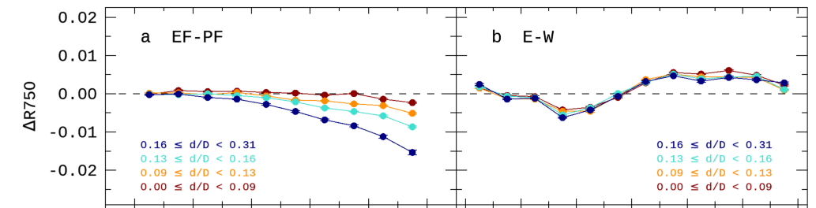
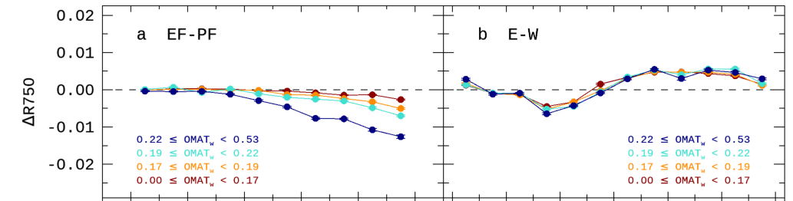
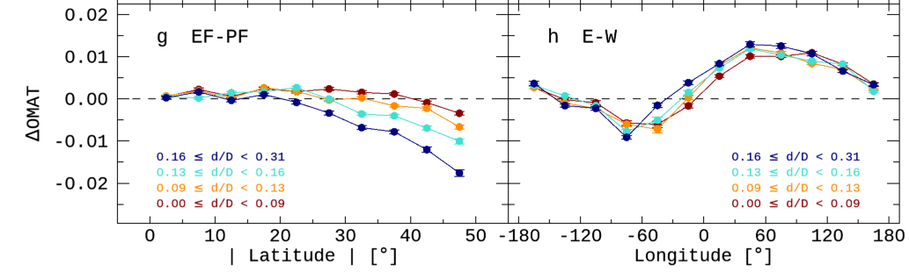
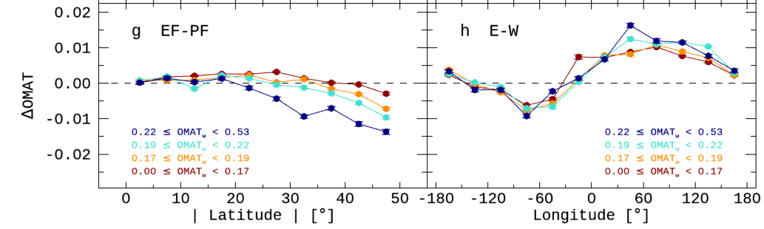
Detailed Analysis – 3: depth-to-Diameter, OMAT
Δ ~ 0 near 0 degree in latitude regardless of d/D and OMAT. ➔ They are not causes of latitudinal asymmetry between N- and S-hemispheres. ➔ These is no longitudinal separation to interpret the longitudinal color offset.
The latitudinal asymmetry is likely to be caused by the space environment,
not by natural processes on the surface of the moon.

Slide 16
Summary & Future Work
Improvements : Updated lunar crater list & Algorithms to define realistic crater features (Ensure statistical significance by reproducing the previous study)
Findings : Latitudinal asymmetry between northern and southern hemispheres Findings : Longitudinal offset caused by northern hemisphere
Causes : Asymmetric impact flux of (micro-)meteorites or secondary particles (ejecta)
It is expected that grain size distribution obtained by PolCam on board Danuri will provide clues to interpret the physical alteration.
 | Compositional or Physical Alteration | Optically
Solar wind particles | nano-phase iron | Mature
Micrometeorites | nano- & micro-phase iron
 | Comminution (grain size become smaller) | Fresh (physically mature)
Meteorites | Excavation or Gardening (fresh soils come up to the surface) | Fresh

Slide 17
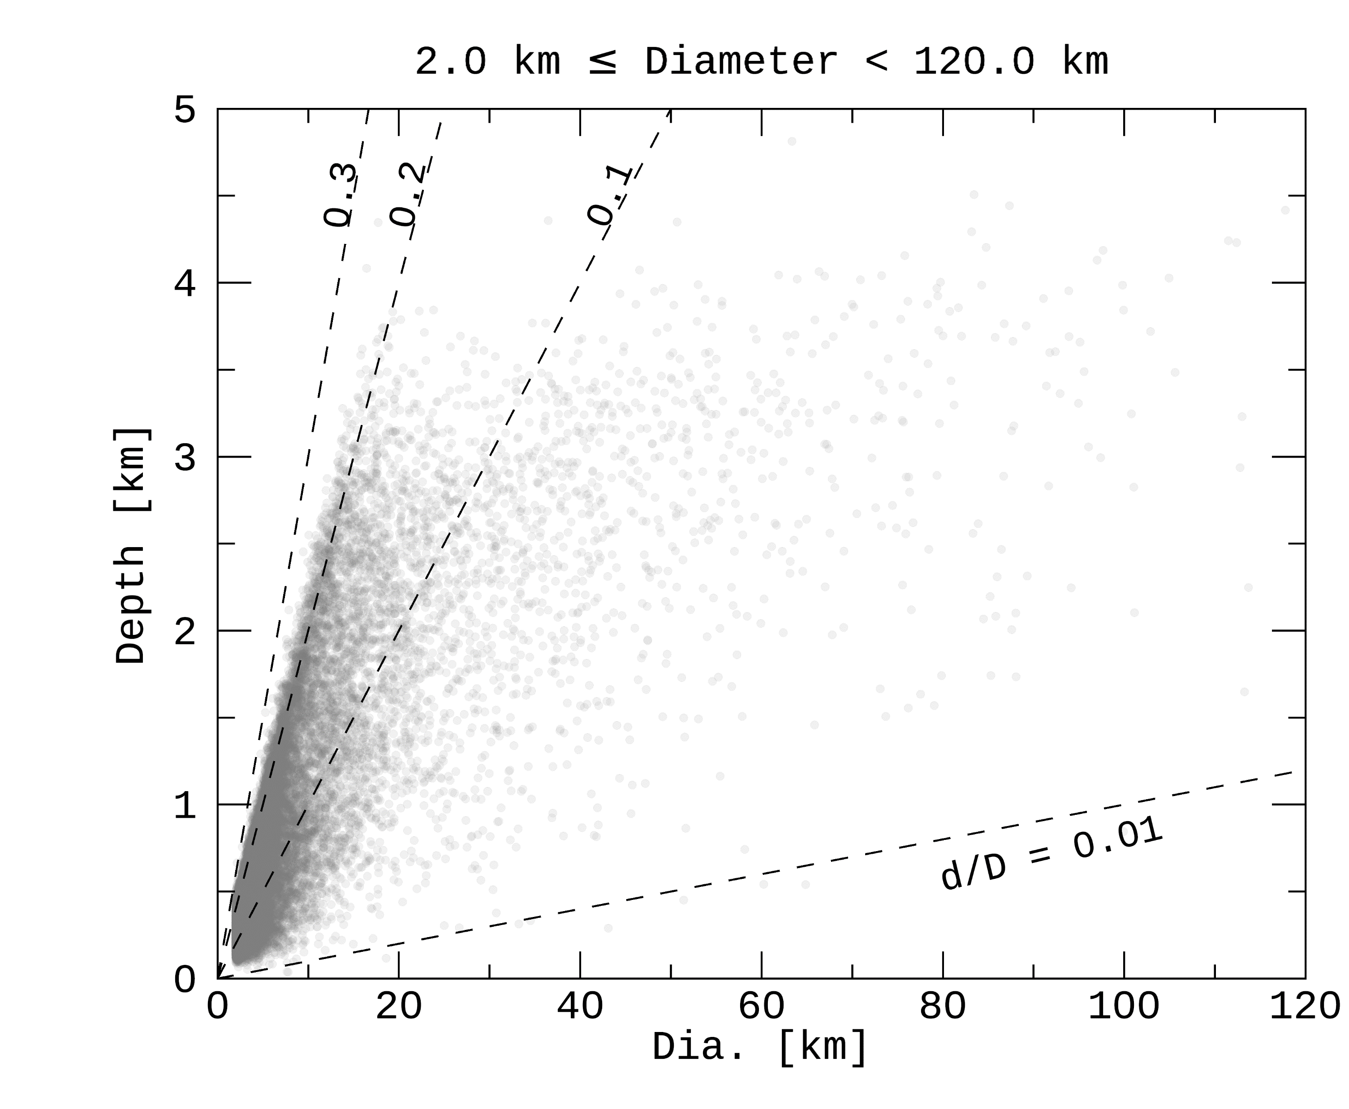
Supplements

Slide 18
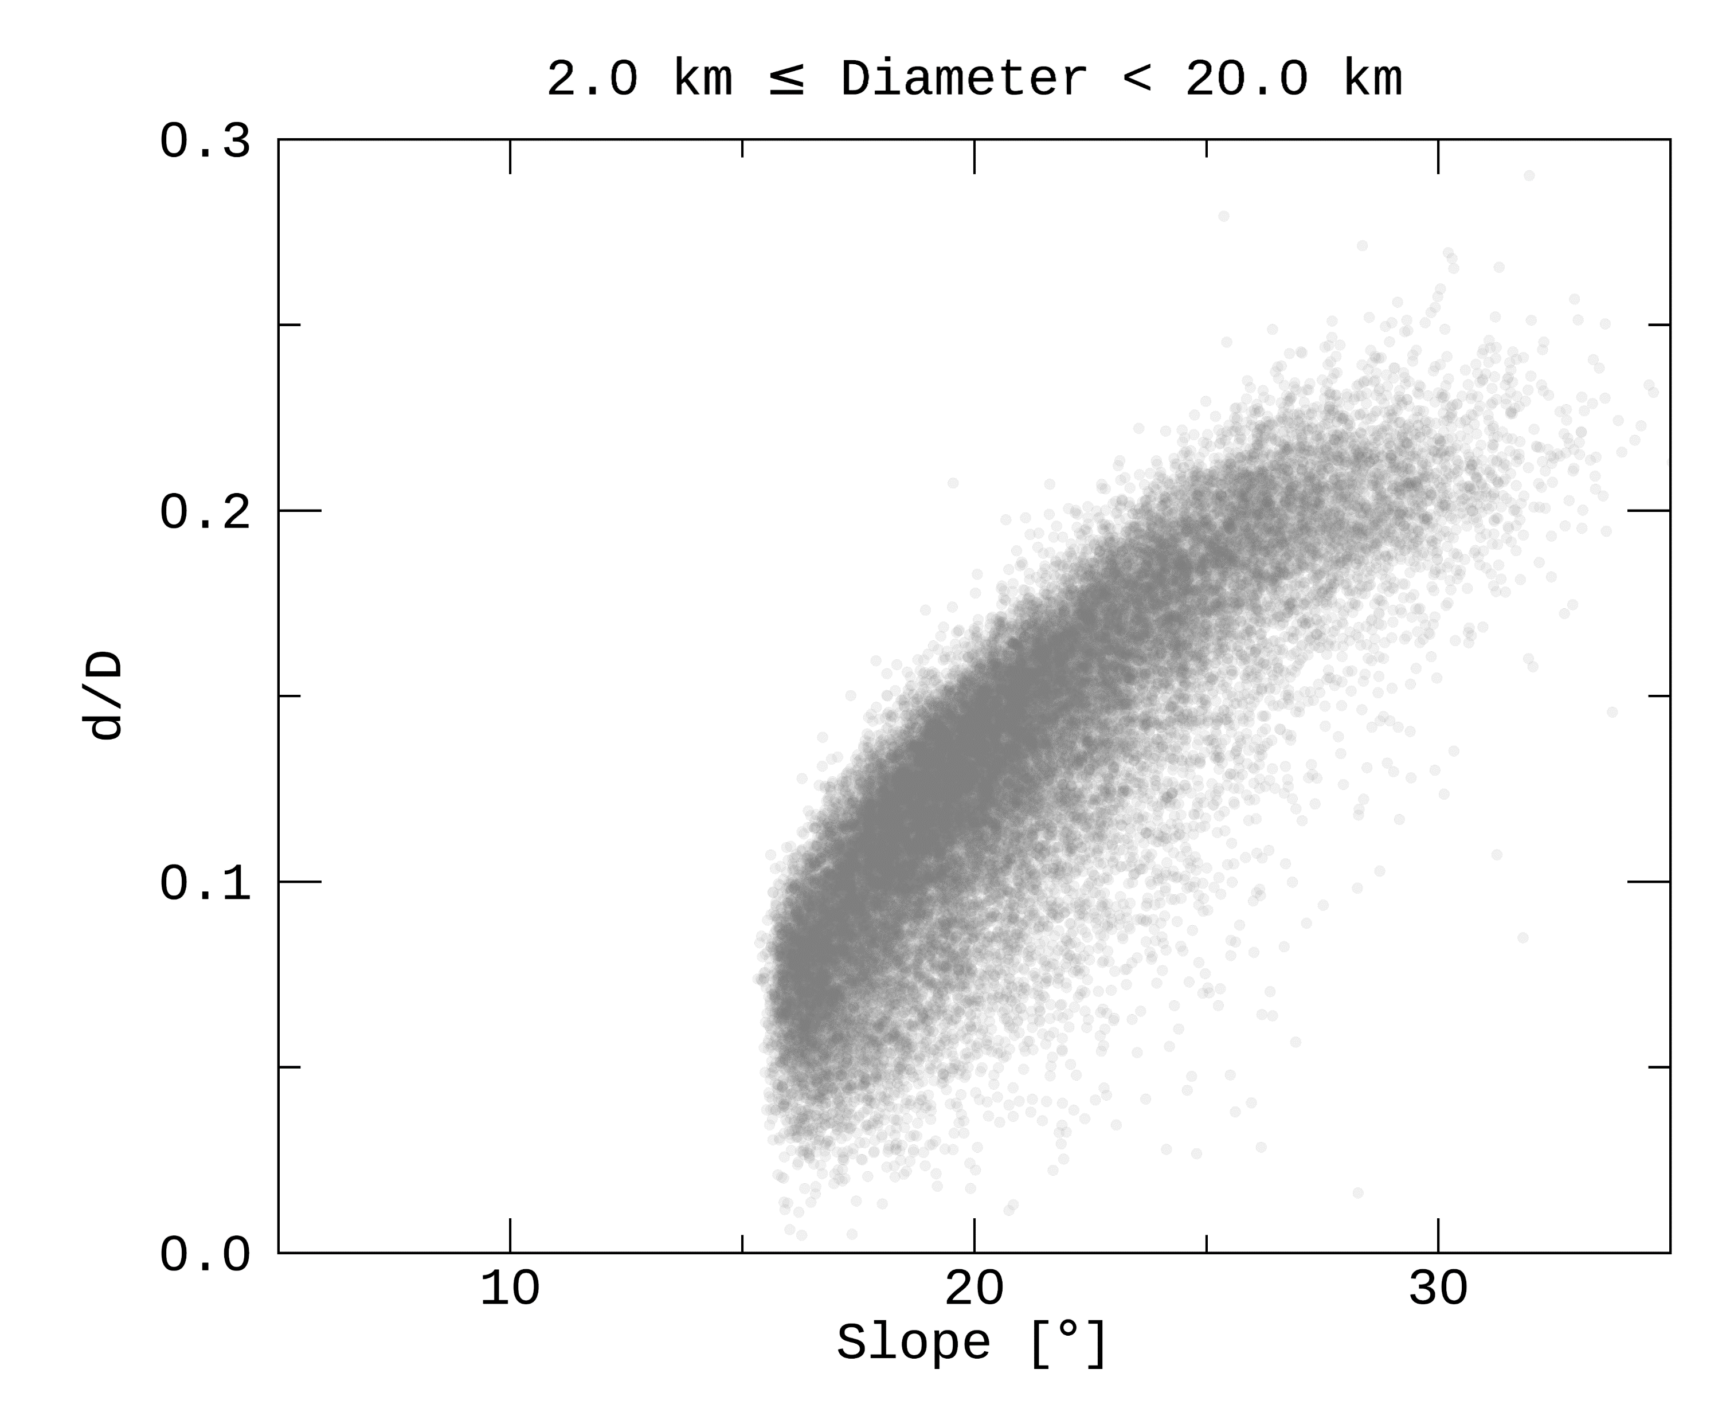
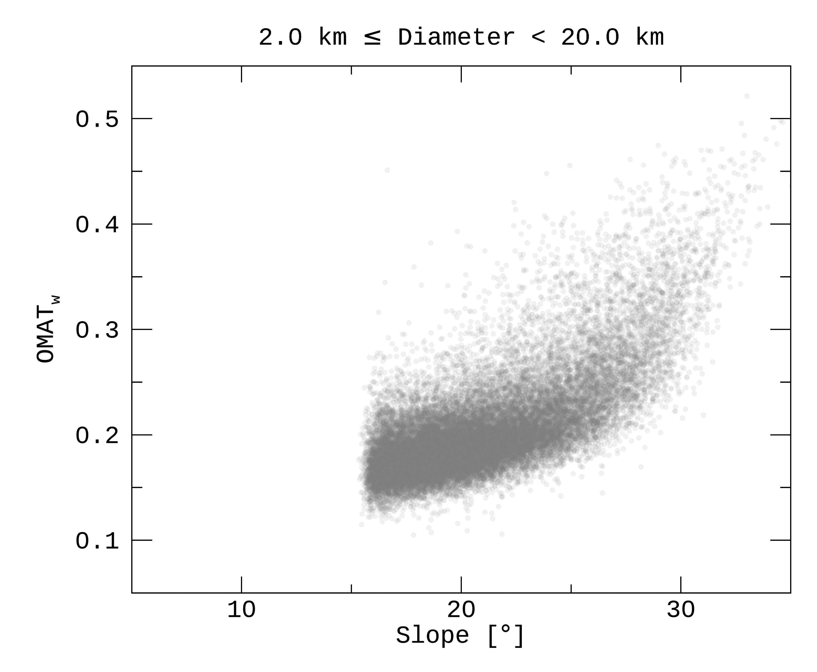
Supplements

Slide 19
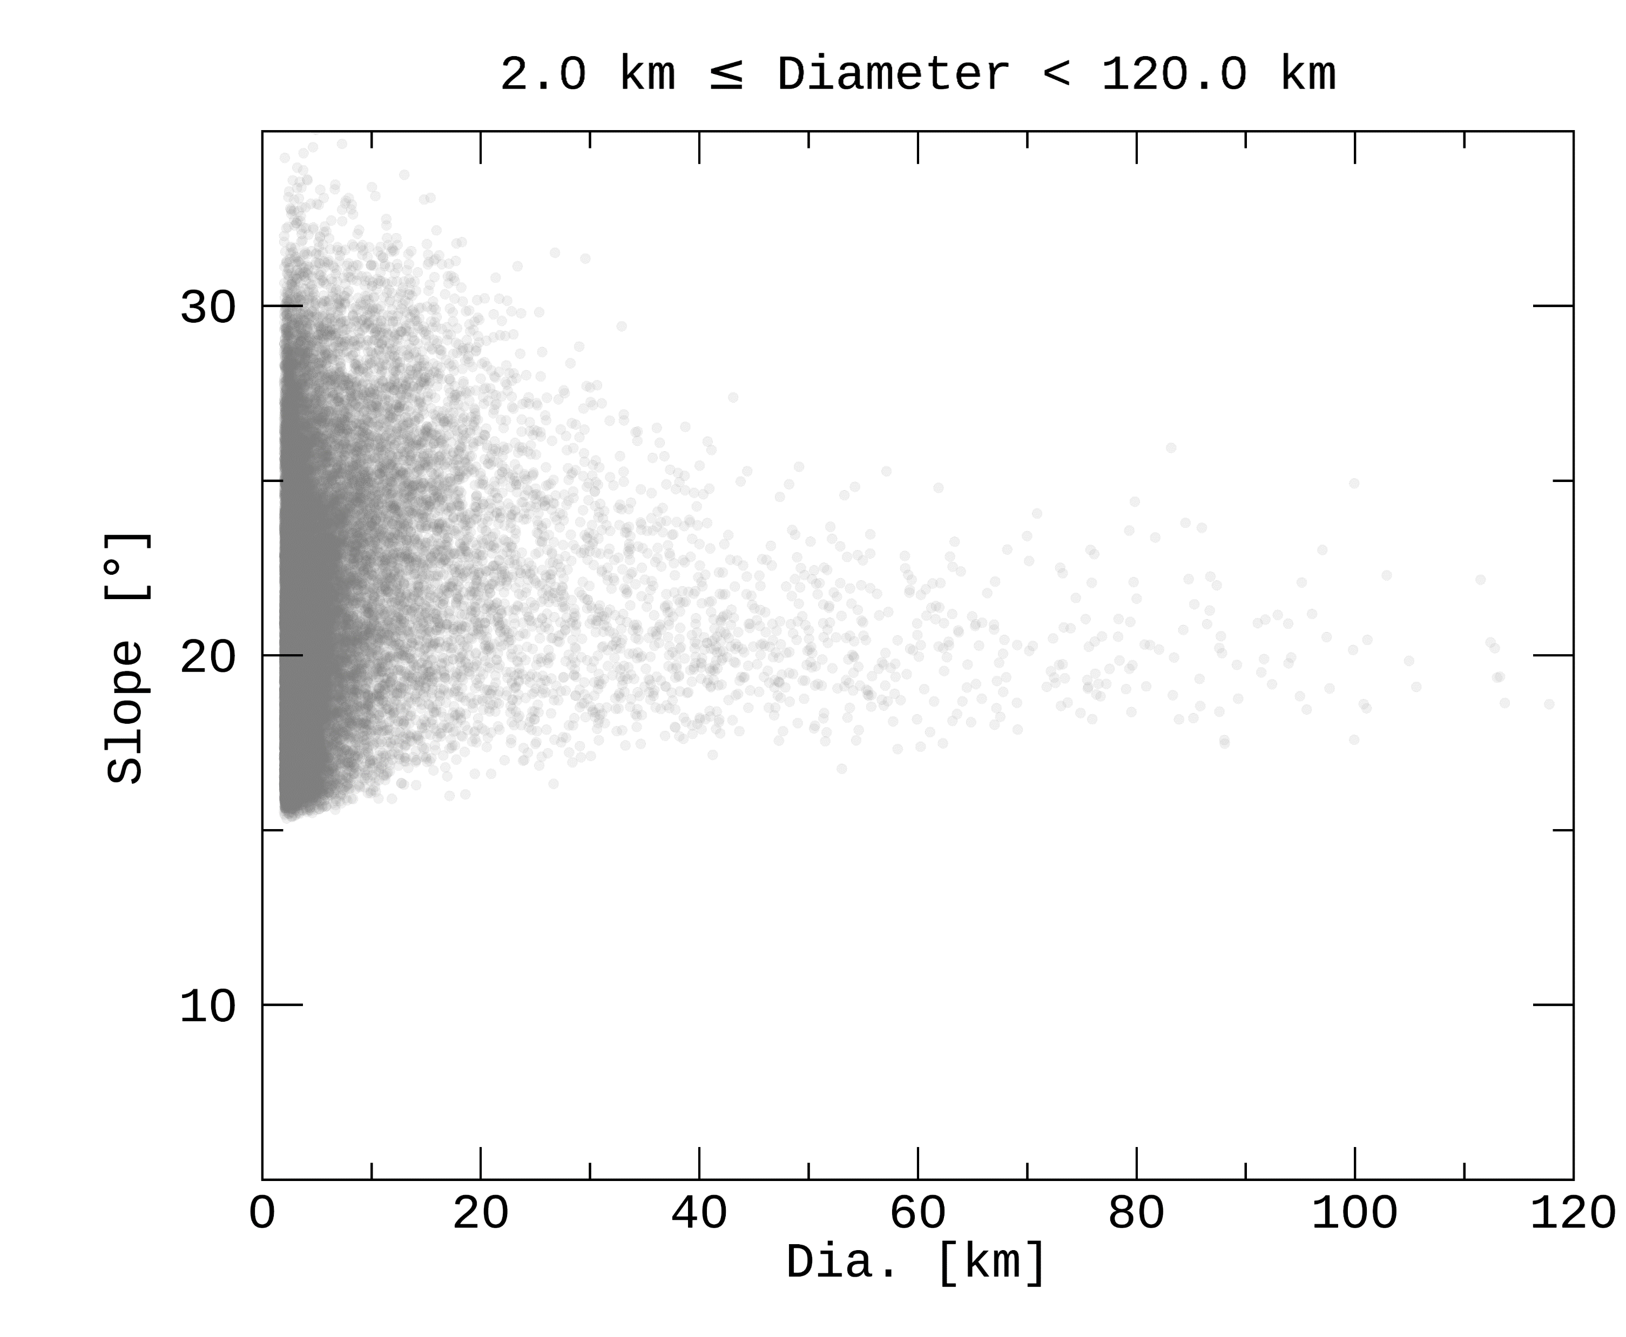
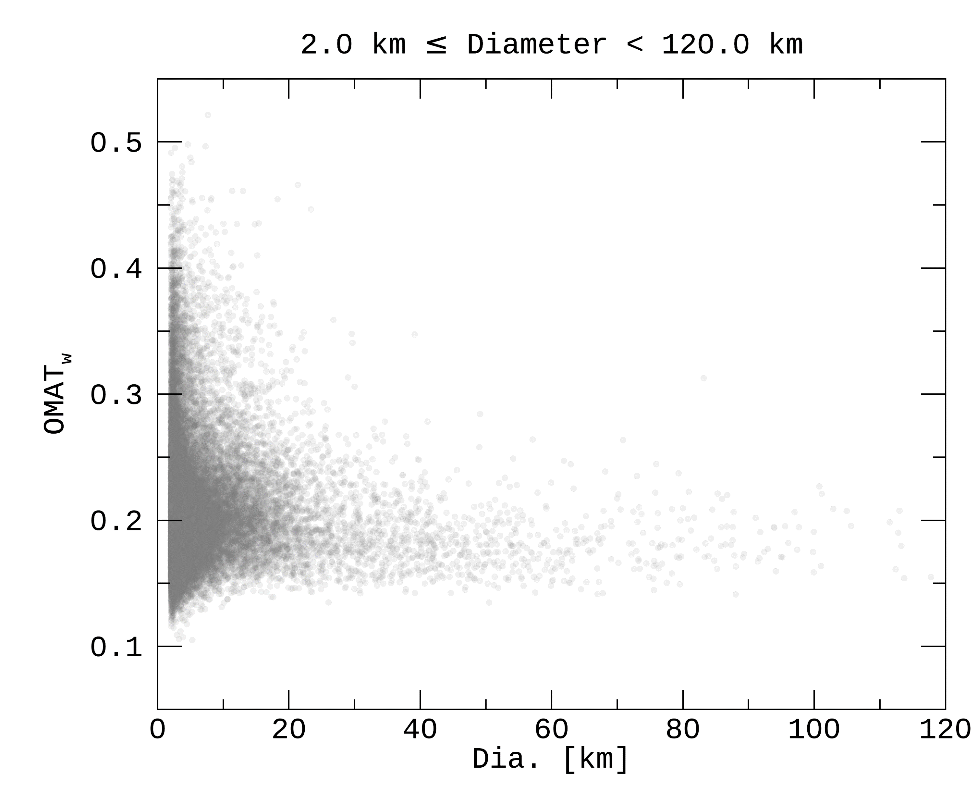
Supplements

Slide 20
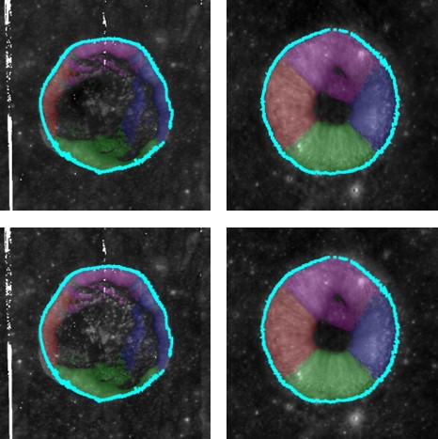
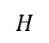
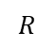
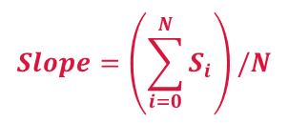





Supplements
Sim et al. (2017)
This study
Slope between two points
Mean of slopes of all pixels on the wall
$$H$$
$$\left(R_{o}, H_{o}\right)$$
$$Slope=\left(\sum_{i=0}^{N}{S_{i}}\right)/N$$
$$Slope=\frac{H_{o}−H_{i}}{R_{o}−R_{i}}$$
$$S_{i+1}$$
$$\left(R_{i}, H_{i}\right)$$
$$S_{i}$$
$$R$$

Slide 21


Supplements

